Slide 1

AI in Medical Imaging: Development and Evaluation of the Impact of AI-based Systems for Medical Image Analysis in Clinical Settings
Hieu Pham, Ph.D.
College of Engineering & Computer Science,
VinUni-Illinois Smart Health Center, VinUniversity
CSL, UIUC, IL
7th April 2023

Slide 2


A bit about the instructor
About me
Ph.D. in Computer Science, Univ. of Toulouse, France (2019).
Research Scientist and Head of Fundamental Research at Medical Imaging Center, Vingroup Big Data Institute (2019 - 2021)
Assistant Professor, CECS, VinUniversity (present)
Associate Director, VinUni-Illinois Smart Health Center, VinUniversity (present)
Research Interests: Artificial Intelligence, Machine Learning, Computer Vision, Deep Learning, Medical Image Analysis, and Smart Healthcare.
VinUniversity Campus, Hanoi, Vietnam
1

Slide 3
A bit about the instructor
Outline
Research directions around medical AI
Current state and key challenges in medical AI
The future of AI in medical imaging research
Develop and evaluate AI-based medical imaging analysis in clinical settings
1

Slide 4
Medical AI Research
Research Directions
Building large-scale, open datasets
We establish open, large-scale, and well-annotated datasets and tools for medical AI development.
1
2
Notes:
AI can help to generate better images with lower radiation.

Slide 5
Medical AI Research
Research Directions
Building large-scale, open datasets
We establish open, large-scale, and well-annotated datasets and tools for medical AI development.
Multimodal biomedical AI
We combine diverse data sources including images, text, and sensors to improve decision-making and generalization in medicine.
1
2
2
Notes:
AI can help to generate better images with lower radiation.

Slide 6
Medical AI Research
Research Directions
Building large-scale, open datasets
We establish open, large-scale, and well-annotated datasets and tools for medical AI development.
Multimodal biomedical AI
We combine diverse data sources including images, text, and sensors to improve decision-making and generalization in medicine.
1
2
Clinician-AI collaboration
We optimize clinician-AI collaboration, designing experiments to evaluate the effectiveness and reliability of AI systems.
3
2
Notes:
AI can help to generate better images with lower radiation.

Slide 7
Medical AI Research
Research Directions
Building large-scale, open datasets
We establish open, large-scale, and well-annotated datasets and tools for medical AI development.
Multimodal biomedical AI
We combine diverse data sources including images, text, and sensors to improve decision-making and generalization in medicine.
1
2
Clinician-AI collaboration
We optimize clinician-AI collaboration, designing experiments to evaluate the effectiveness and reliability of AI systems.
3
Clinically Trusted AI
We build explainable and interpretable AI solutions for medical applications.
4
2
Notes:
AI can help to generate better images with lower radiation.

Slide 8
Medical AI Research
Research Directions
Building large-scale, open datasets
We establish open, large-scale, and well-annotated datasets and tools for medical AI development.
Multimodal biomedical AI
We combine diverse data sources including images, text, and sensors to improve decision-making and generalization in medicine.
1
2
Build AI-based solutions to improve medical decision-making
Clinician-AI collaboration
We optimize clinician-AI collaboration, designing experiments to evaluate the effectiveness and reliability of AI systems.
3
Clinically Trusted AI
We build explainable and interpretable AI solutions for medical applications.
4
2
Notes:
AI can help to generate better images with lower radiation.

Slide 9
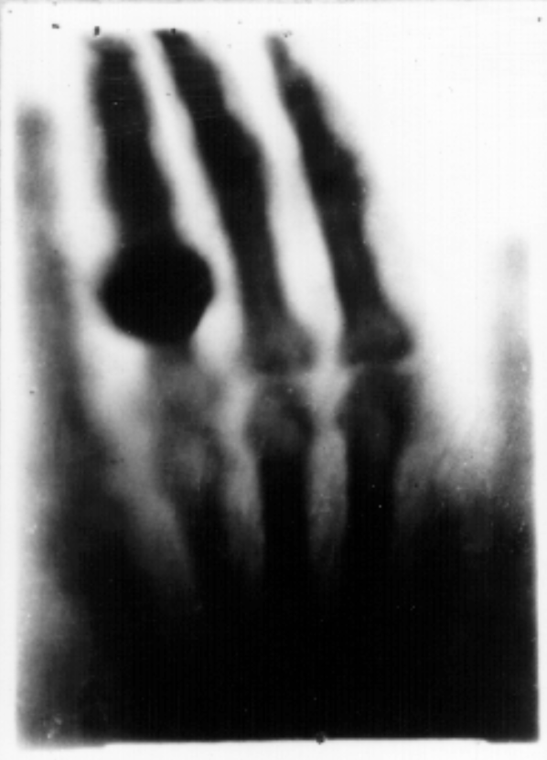
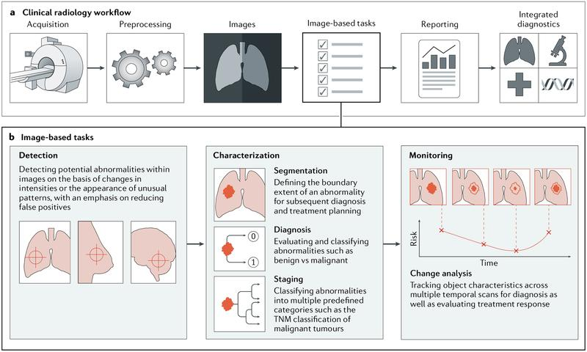
Medical AI Research
What is Medical Imaging?
Medical imaging refers to techniques and processes used to create images of various parts of the human body for diagnostic and treatment purposes.
First medical X-ray by Wilhelm Röntgen, 1986 (source)
Ahmed Hosny et al. “Artificial Intelligence in Radiology”, Nat Rev Cancer, 2018
2
Notes:
AI can help to generate better images with lower radiation.

Slide 10
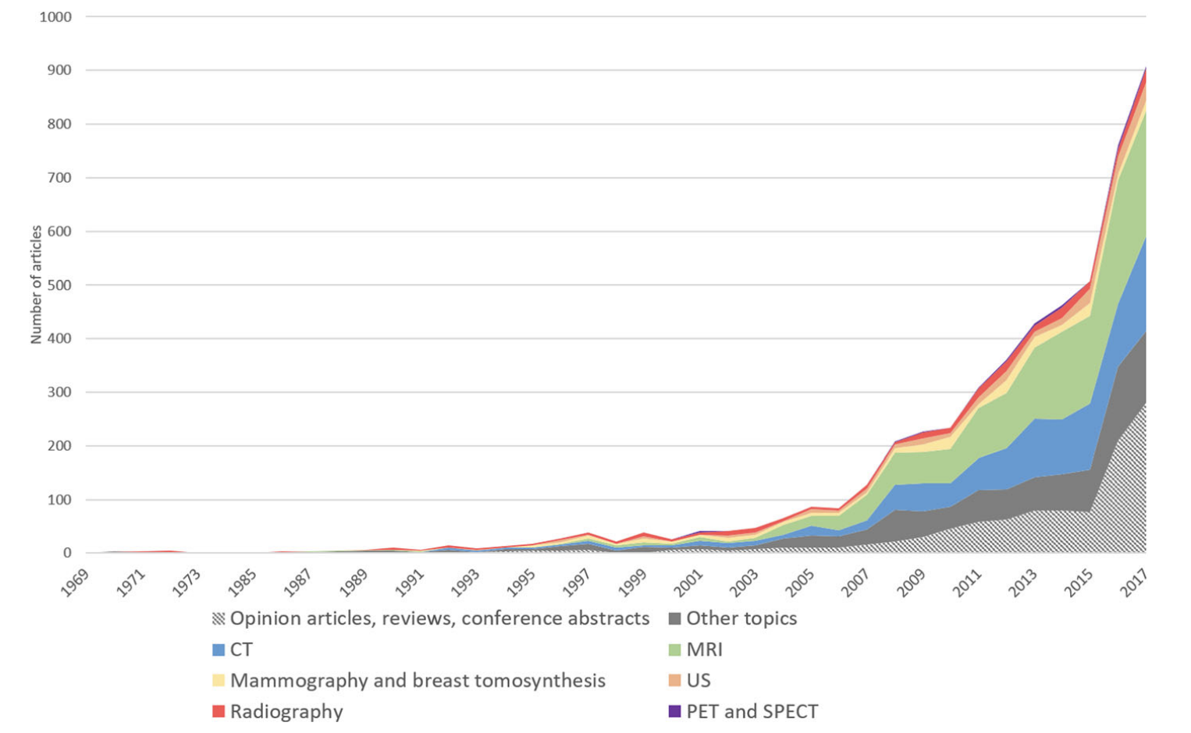
Medical AI Research
The Rise of AI/Deep Learning in Medical Imaging
MICCAI 2018 paper statistics
International Conference on Medical Image Computing and Computer-Assisted Intervention - MICCAI (top conference in medical imaging)
>1,600 attendees
>1,300 submission
+33%
Number of publications indexed by EMBASE obtained using the search query “Machine learning OR Deep learning AND Medical Imaging”. Pesapane et al. "Artificial intelligence in medical imaging: threat or opportunity? Radiologists again at the forefront of innovation in medicine." European Radiology Experimental 2.1 (2018)
3

Slide 11
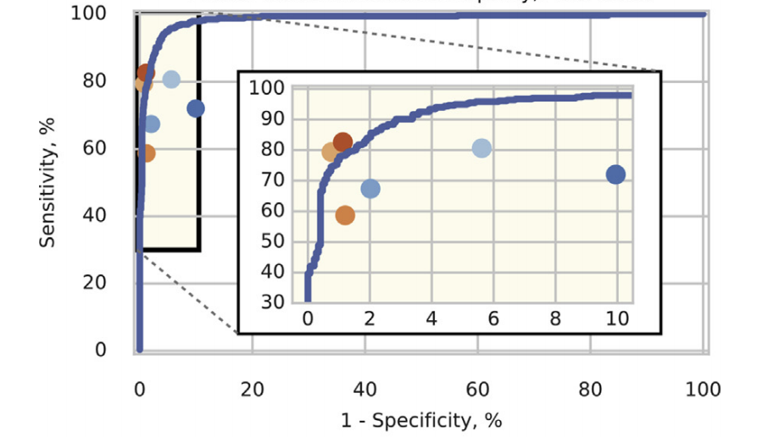
Recent advances in Medical AI
The current state of Medical AI
2016: Geoffrey Hinton, the godfather of neural networks, said that it's “quite obvious that we should stop training radiologists”.
Last 3 - 5 years: Increased activities in the development of AI for radiology.
For narrow-based tasks, the accuracy rates of deep CNNs surpass those human.
Toward foundation models for healthcare and medicine (e.g. )
Diabetic retinopathy detection using AI. The system performed better with several medical doctors and reached the best doctors.
Jonathan Krause et al. “Grader Variability and the Importance of Reference Standards for Evaluating Machine Learning Models for Diabetic Retinopathy” - Ophthalmology 2018.
5

Slide 12
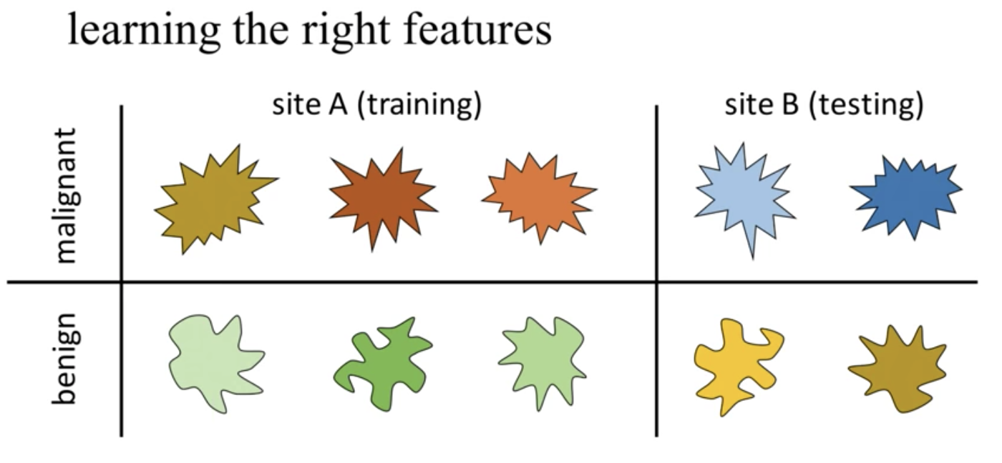
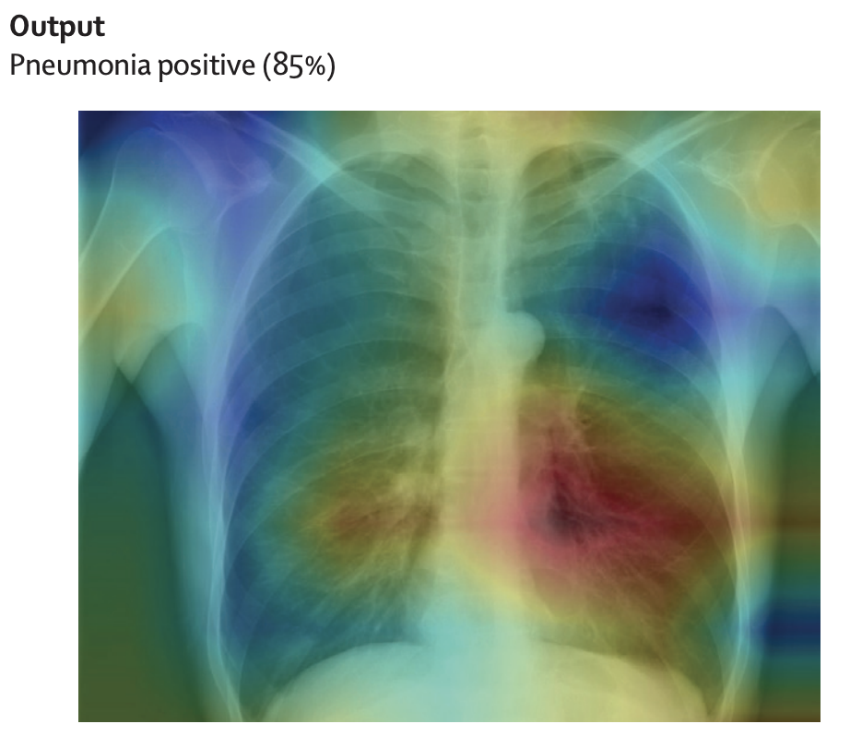
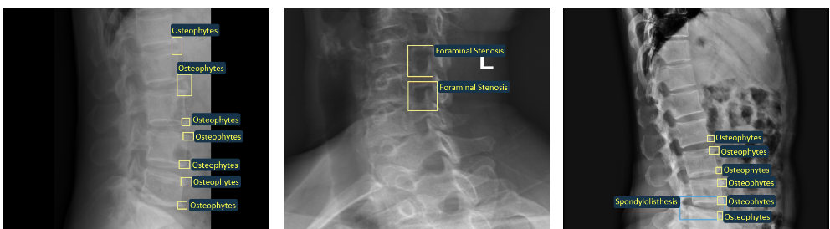
Key Challenges in Medical AI
Lack of benchmark dataset Domain shift problem Explainable AI (XAI)
Medical data are hard to retrieve, costly, and time-consuming to build
Physicians’ time is precious. The annotation of medical images requires a consensus of several expert readers to overcome human bias
It lacks an efficient labeling framework to manage and annotate large-scale
We typically assume that the training dataset and test dataset share the same data distribution
But not!
The lack of explainability prevents the use of AI systems at scale
It is still an open challenge
Spine X-ray scans with radiologists’ annotations
Ben Glocker, Imperial College London, 2019.
Head-map produced by XAIs.
9

Slide 13
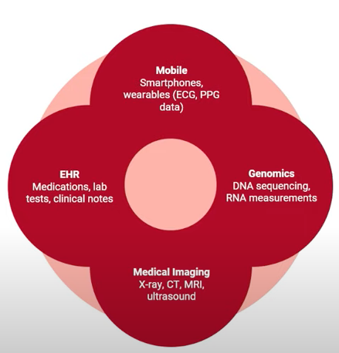
The future of AI in medical imaging research
Key question: How to automate medical decision-making tasks to improve patient outcomes?
1. Open-benchmark datasets
Collect and normalize data, high-quality data
Private data to public data
2. Label-efficient Medical AI
Switching from label-intensive to label-efficient
E.g. self-supervised & multimodal learning
3. Clinician-AI collaboration
Clinician → Clinician + AI
Sourced from Rajpurkar Lab
13

Slide 14
The future of AI in medical imaging research
Shifting machine learning for healthcare from development to deployment and from models to data
Key strategies:
Moving from model development to model deployment.
Data plays a central role (Data-Centric).
Deep generative models and federated learning as strategies to augment datasets for improved model performance and anonymize patient data.
The use of the more recent transformer models for handling larger datasets and enhancing the modeling of clinical text.
14

Slide 15
The future of AI in medical imaging research
Multimodal medical AI
Most of the current applications of AI in Medicine have addressed narrowly defined tasks using one data modality.
In contrast, clinicians process data from multiple sources and modalities when diagnosing, making prognostic evaluations and deciding on treatment plans.
AI assessments are typically one-off snapshots, based on a moment of time when the assessment is performed, and therefore not ‘seeing’ health as a continuous state.
Multimodal medical AI + continuous data unlocks key applications in healthcare.
Acosta, J.N., Falcone, G.J., Rajpurkar, P. et al. Multimodal biomedical AI. Nat Med (2022). DOI: 10.1038/s41591-022-01981-2
15

Slide 16
Our research in Medical AI
Main focuses:
1. Building large-scale datasets of medical images for multiple imaging modalities (X-ray, CT, MRI) and highly-demanding diseases → Define new research problems and publish benchmark datasets.
2. Develop and evaluate AI-based approaches for a wide range of diagnostic applications in medical image analysis and smart healthcare → Investigate their performance in clinical settings.
16

Slide 17
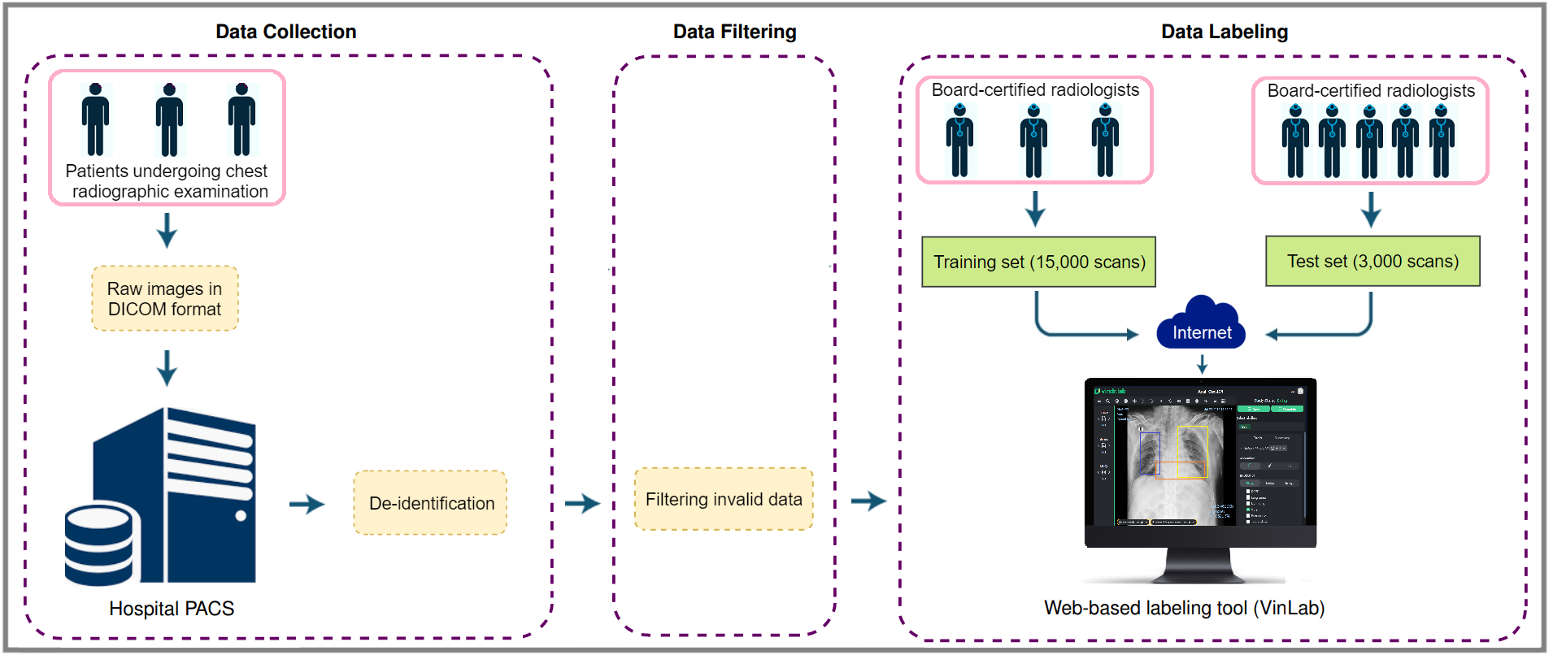
Our research on AI and Healthcare
Data collection (working with 10 major hospitals in Vietnam and 50 radiologists)
Step 1: raw images in DICOM format were collected retrospectively from the hospital’s PACS and got de-identified to protect the patient’s privacy. Step 2: invalid files (e.g. other modalities, other body parts, low quality, or incorrect orientation) were automatically filtered out by a CNN-based classifier. Step 3: A web-based labeling tool was developed to store, manage, and remotely annotate DICOM data (Nguyen, Ha Q., et al. Nature Scientific Data, 2022)
17

Slide 18
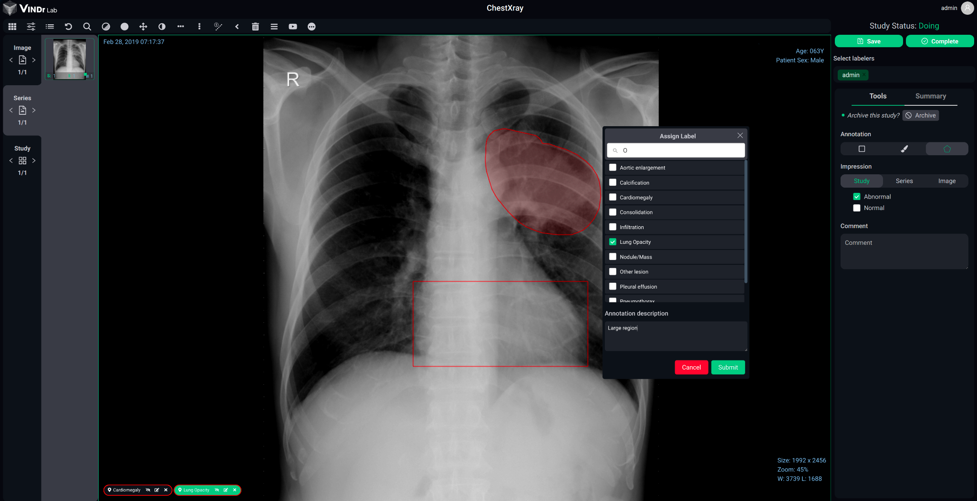
Our research on AI and Healthcare
Our labeling solution for building high-quality datasets and algorithms with lean processes and experienced experts
18

Slide 19
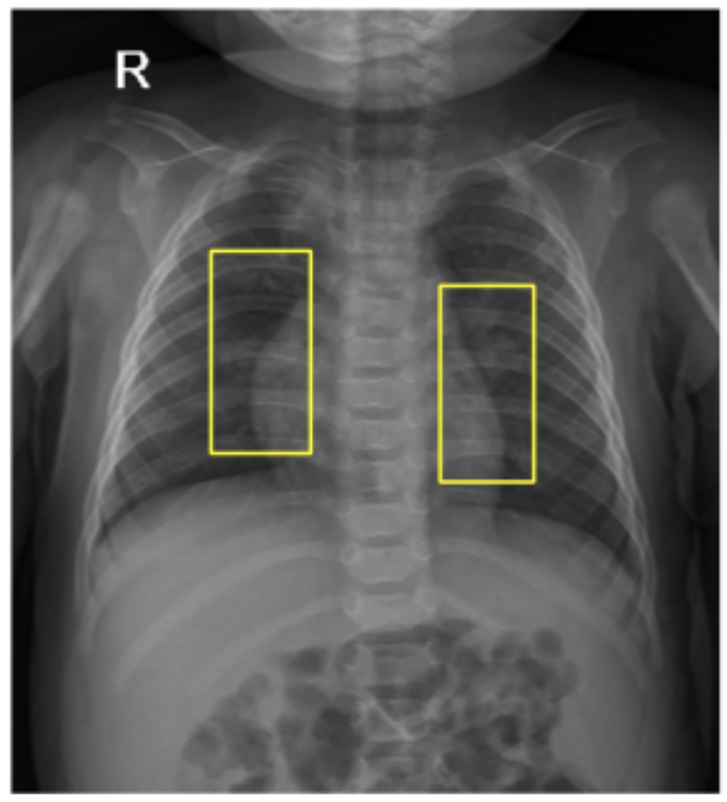
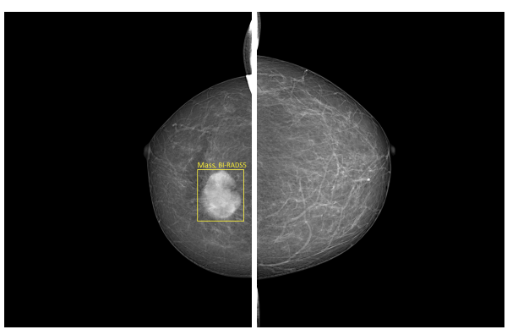
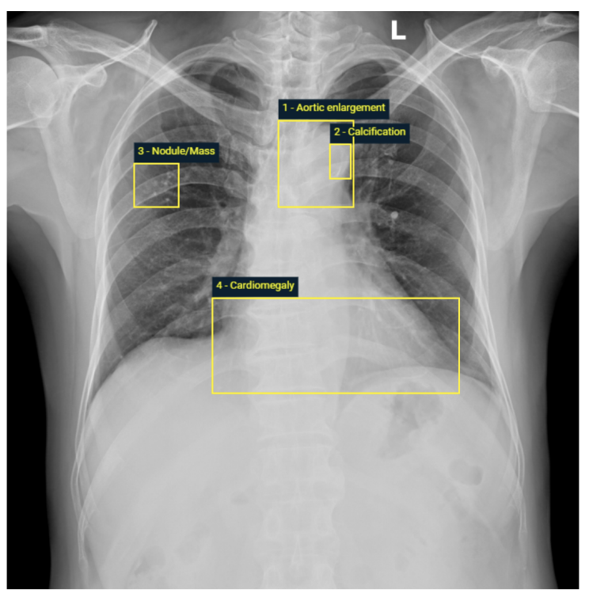
Building large-scale, open and annotated datasets
*VinDr-CXR Dataset **VinDr-PCXR Dataset *** VinDr-Mammo
(100,000 studies) (~10,000 studies) (5,000 studies)
* Hieu Pham et al. “VinDr-CXR: An open dataset of chest X-rays with radiologist's annotations”, Scientific Data (Nature), 2022
** Hieu Pham et al. “VinDr-PCXR: An open, large-scale chest radiograph dataset for interpretation of common thoracic diseases in children” - Preprint https://arxiv.org/pdf/2203.10612.pdf. - Scientific Data (Nature), 2023
*** Hieu Pham et al. “VinDr-Mammo: A large-scale benchmark dataset for computer-aided diagnosis in full-field digital mammography”, medRxiv preprint doi: https://doi.org/10.1101/2022.03.07.22272009 - Scientific Data (Nature), 2023
19

Slide 20
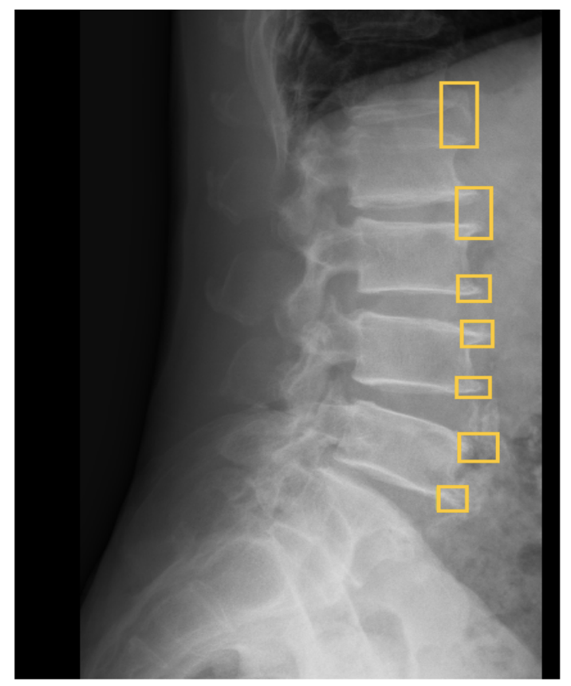
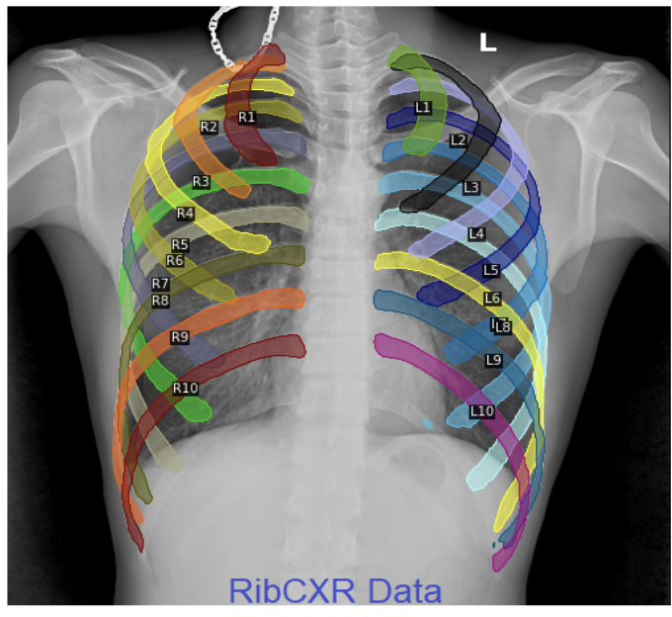
Building large-scale, open and annotated datasets
*VinDr-SpinXR Dataset **VinDr-RibCXR Dataset
10,468 images 250 images
*Hieu Pham et al. “VinDr-SpineXR: A deep learning framework for spinal lesions detection and classification from radiographs”, MICCAI 2022,
*** Hieu Pham et al. “VinDr-RibCXR: A Benchmark Dataset for Automatic Segmentation and Labeling of Individual Ribs on Chest X-rays”, MIDL 2021.
20

Slide 21
Building AI Models for Medical Imaging Analysis
20

Slide 22
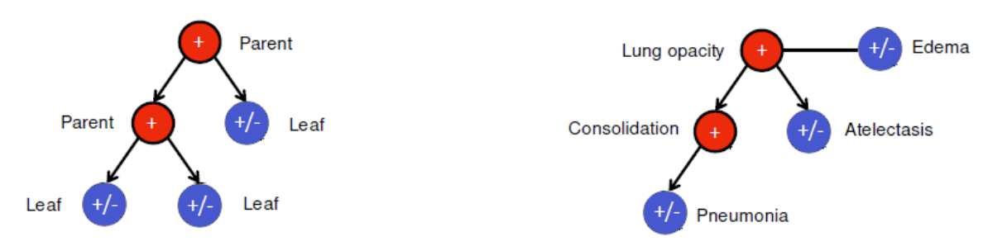
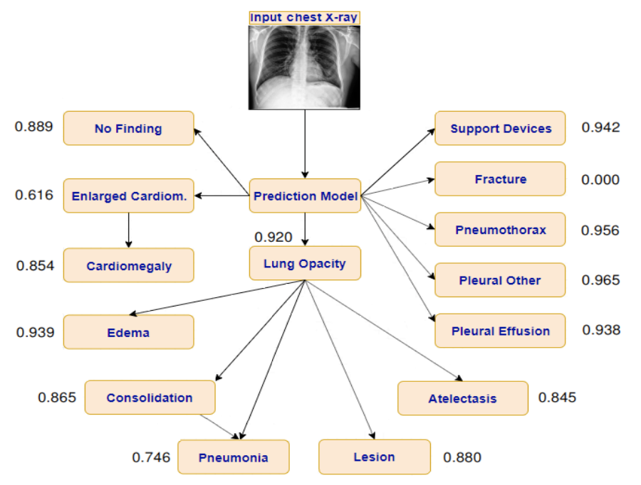
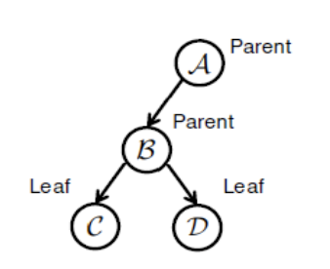
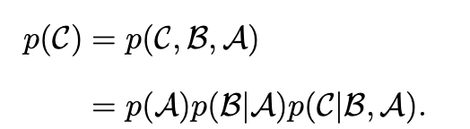
Building AI models for Medical Imaging Analysis
Interpreting chest X-rays via CNNs that exploit hierarchical disease dependencies
We proposed the conditional training mechanism. A CNN is trained on a training set where all parent labels (red nodes) are positive, to classify leaf labels (blue nodes), which could be either positive or negative.
We build a deep learning system for predicting the probability of the presence of 14 different pathologies or observations from the CXRs. Pham, Hieu H., et al. Neurocomputing 437 (2021): 186-194.
For inference, the probability of each label being positive should be computed by multiplying all conditional probabilities produced by the CNN along the path from the root node to the current label.
42
25

Slide 23
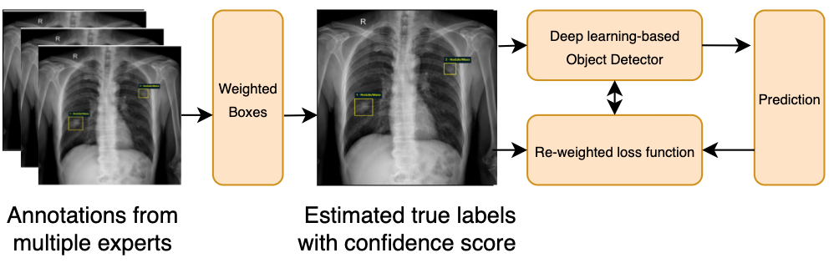
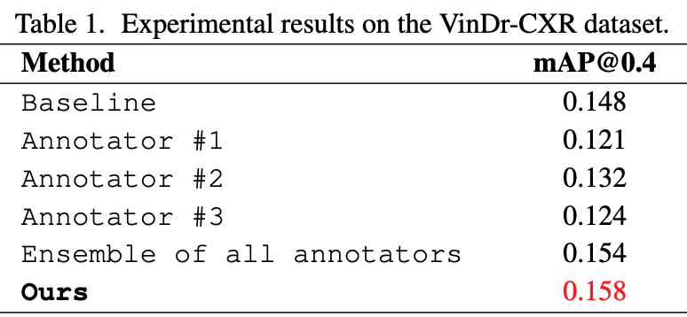
Building AI models for Medical Imaging Analysis
Improving Object Detection in Medical Image Analysis through Multiple Expert Annotators: An Empirical Investigation
Here we introduce a simple yet effective method that allows a deep-learning network to learn from multiple annotators. It aims at estimating the true annotations from multiple experts with confidence scores and uses these annotations to train a deep learning-based detector. This helps remove uncertainty in the learning process and provides higher label quality to train predictive models.
Pham, Hieu H., et al. "Improving Object Detection in Medical Image Analysis through Multiple Expert Annotators: An Empirical Investigation." arXiv preprint arXiv:2303.16507 (2023).
42
25

Slide 24
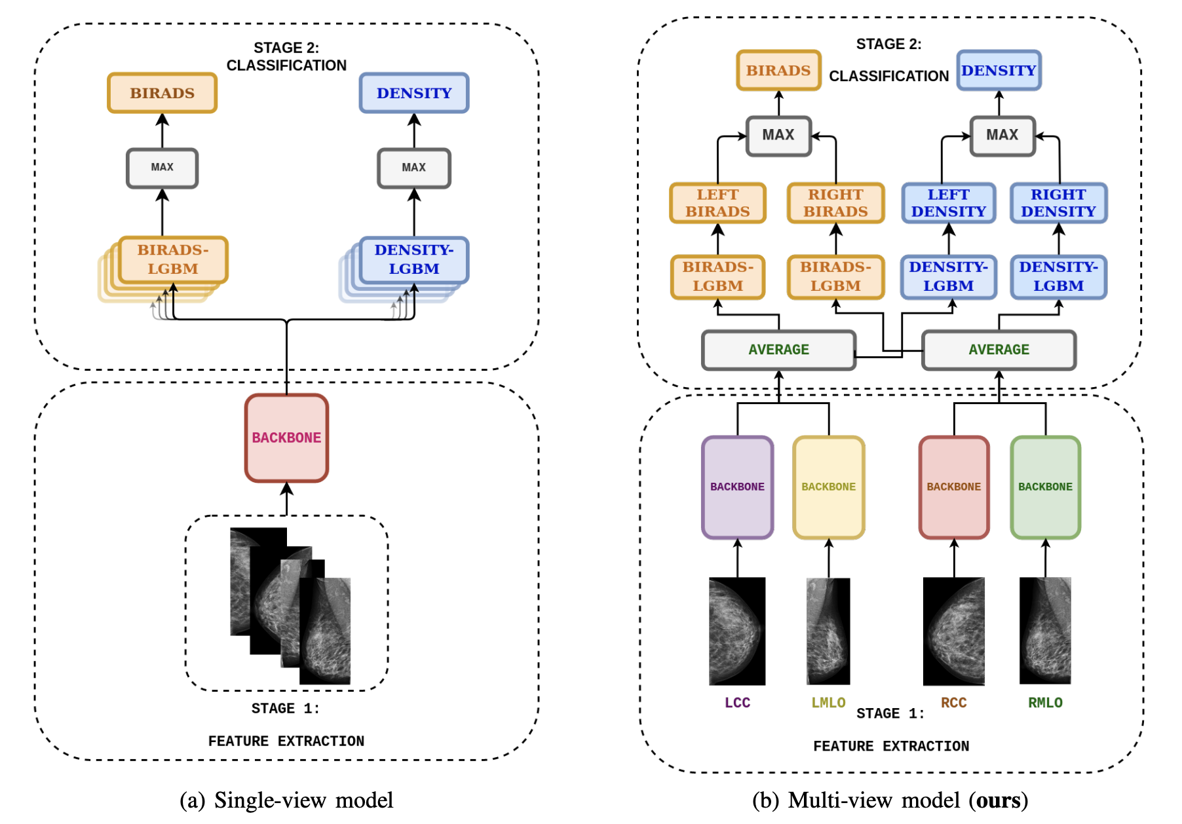
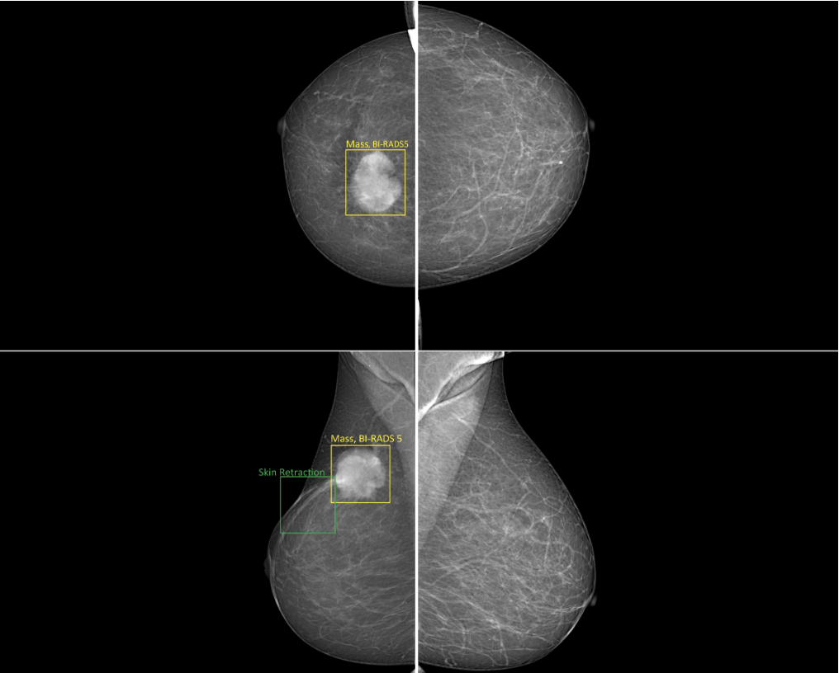
Building AI models for Medical Imaging Analysis
Development and validation of a deep learning-based framework for breast cancer detection on mammograms
A typical mammogram consists of 4 views.
Nguyen, Huyen TX, et al. "A novel multi-view deep learning approach for BI-RADS and density assessment of mammograms." 2022 44th Annual International Conference of the IEEE Engineering in Medicine & Biology Society (EMBC). IEEE, 2022.
42
26

Slide 25
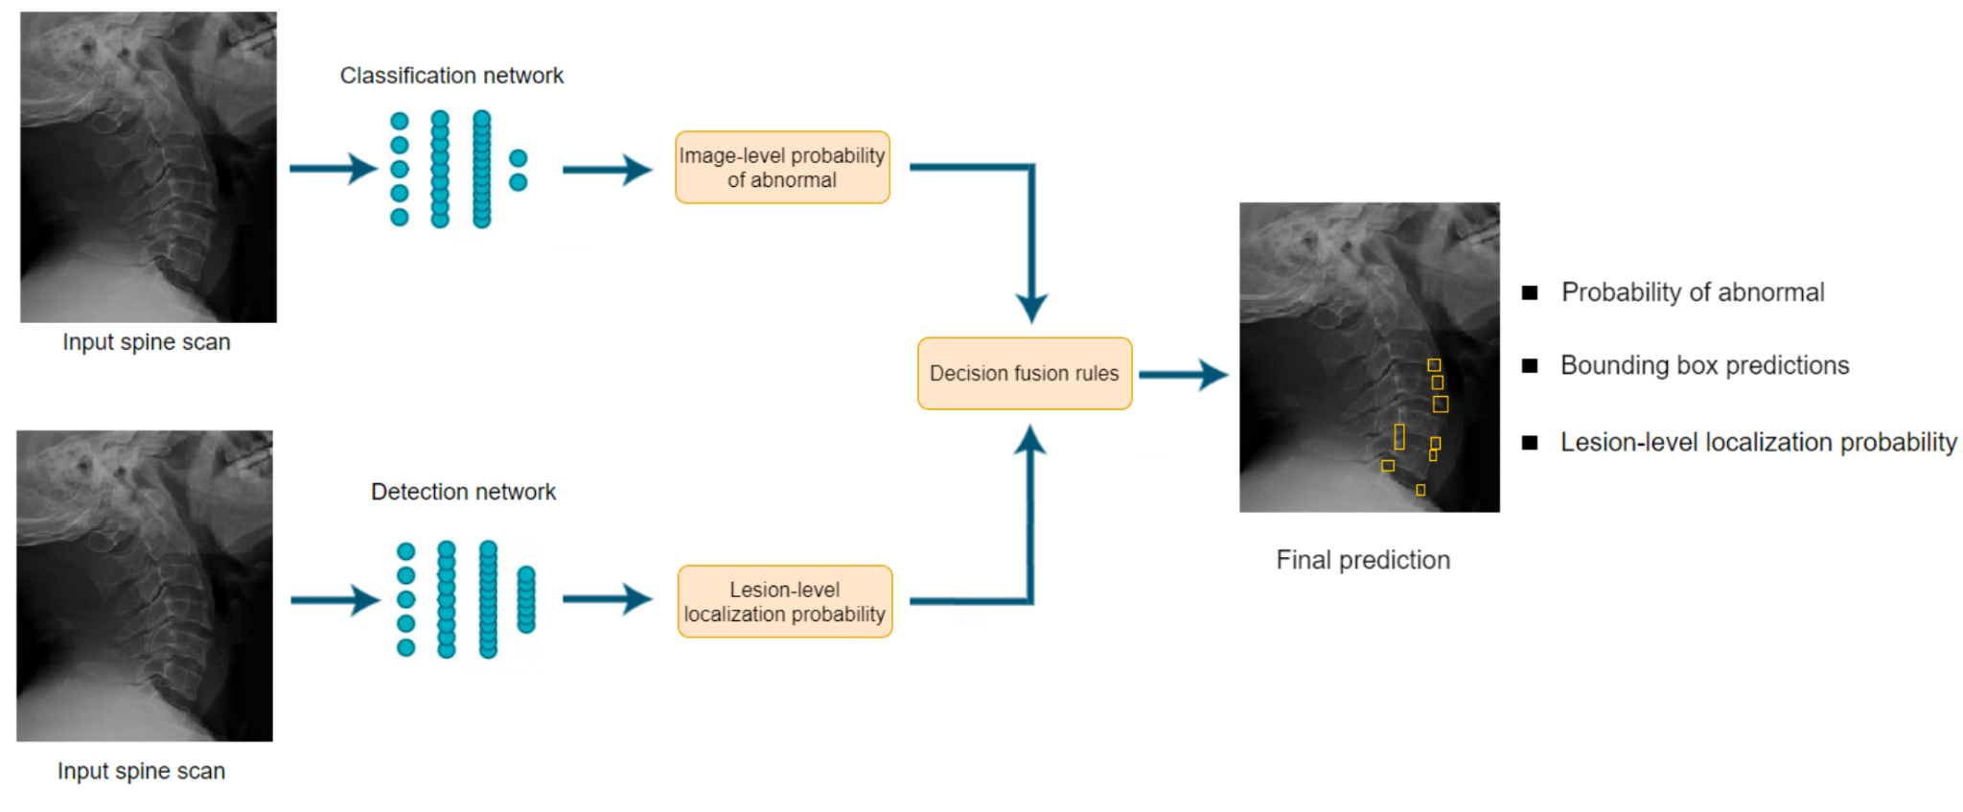
Building AI models for Medical Imaging Analysis
Development and validation of a deep learning-based framework for spinal lesions detection and classification from radiograph
Hieu Nguyen, Hieu Pham, Ha Quy Nguyen. “Development and validation of a deep learning-based framework for spinal lesions detection and classification from radiographs” - MICCAI 2022.
42
25

Slide 26
Evaluation of the Impact of AI-based Systems for Medical Image Analysis in Clinical Settings
Why it matters?
“Despite the promise of AI to improve clinical outcomes, reduce costs, and meaningfully improve patient lives, very few models are deployed. For example, of the roughly 593 models developed for predicting outcomes among COVID-19 patients, practically none are deployed for use in patient care”
Wynants, Laure, et al., BMJ 369 (2020).
40
27

Slide 27
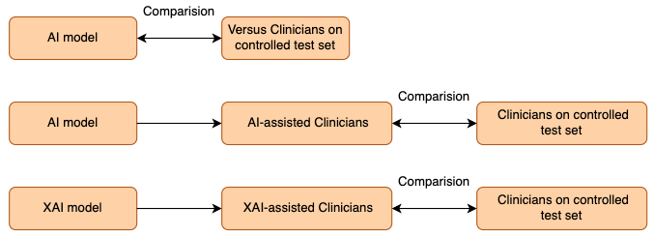
Clinical evaluation of AI models
Clinical evaluation: Does AI really help radiologists?
Experiment 1
Experiment 2
Experiment 3
Designing some simple experiments to evaluate the effectiveness and reliability of AI systems.
37
28

Slide 28
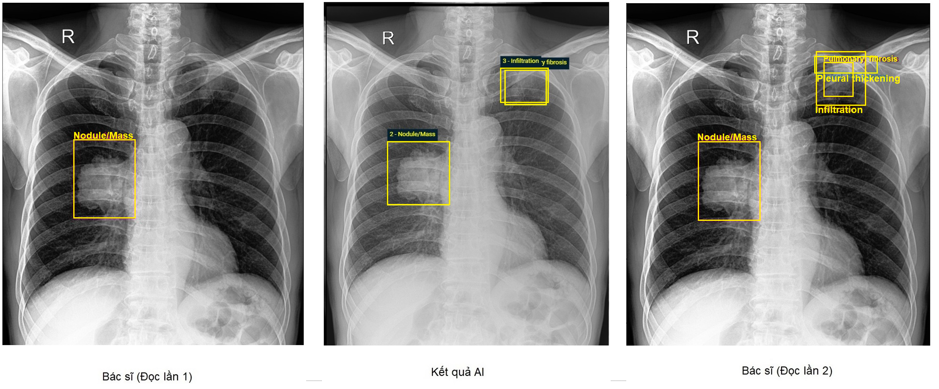
Clinical evaluation of AI models
Clinical evaluation: Does AI really help radiologists?
Radiologist (1st read) AI Radiologist within AI-assisted
37
28

Slide 29
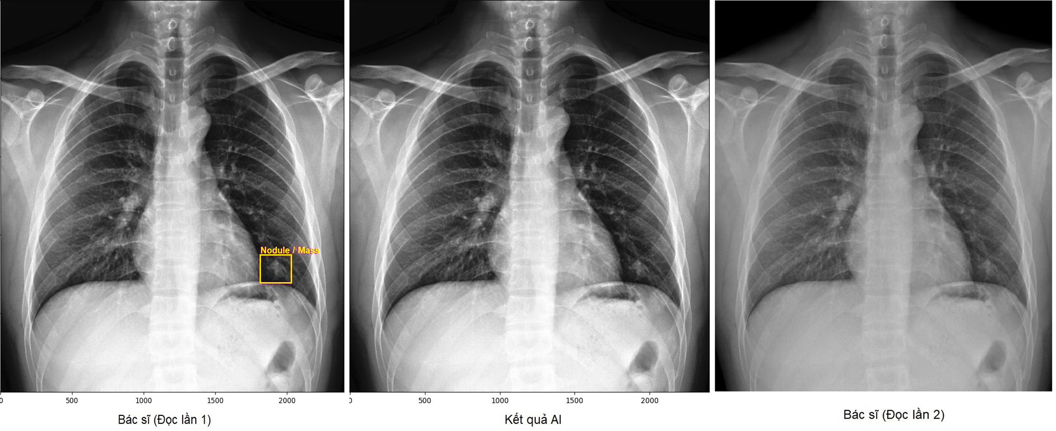
Our research on AI and Healthcare
Clinical evaluation: Does AI really help radiologists?
Radiologist (1st read) AI Radiologist within AI-assisted
Hieu Pham et al. “An Accurate and Explainable Deep Learning System Improves Interobserver Agreement in the Interpretation of Chest Radiograph” Preprint https://arxiv.org/abs/2208.03545
29

Slide 30
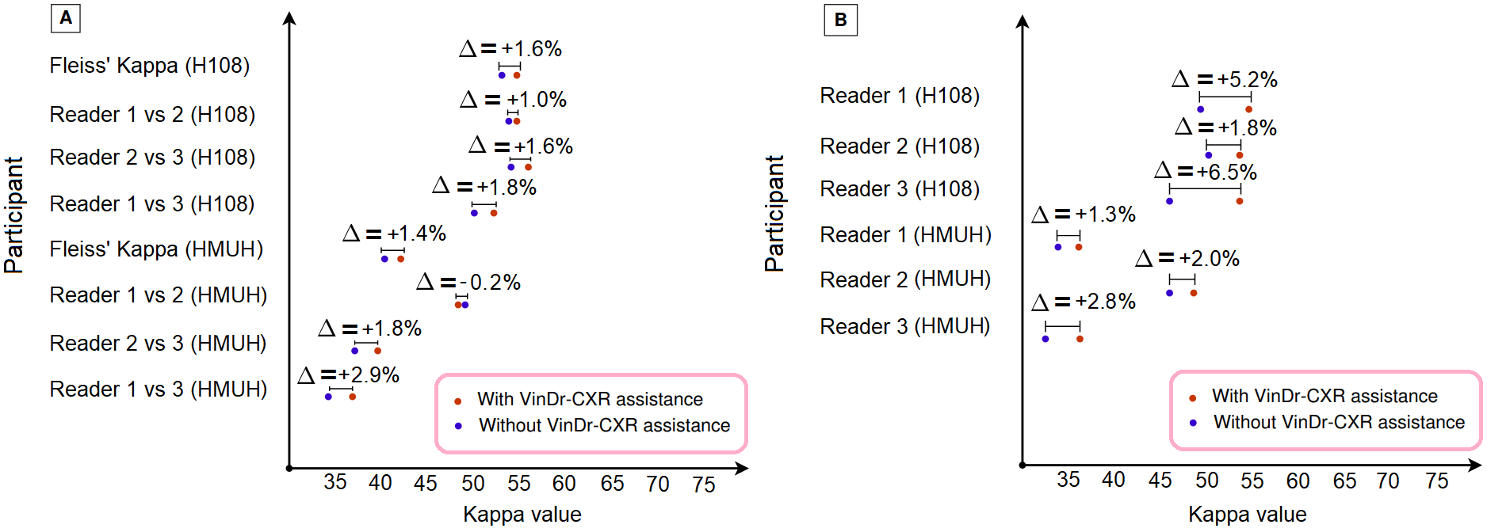
Clinical evaluation of AI models (AI vs. without AI)
When used as a diagnosis supporting tool, AI model significantly improved the agreement between radiologists themselves with an increase of 1.5% in mean Fleiss’ Kappa.
We also observed that, after the radiologists consulted VinDr-CXR’s suggestions, the agreement between each of them and the system was remarkably increased by 3.3% in mean Cohen’s Kappa.
Pham, Hieu H., et al. "An Accurate and Explainable Deep Learning System Improves Interobserver Agreement in the Interpretation of Chest Radiograph." IEEE Access 10 (2022): 104512-104531.
29

Slide 31
Use cases for AI in healthcare
A few remarks
From experiments, AI does help radiologists in spotting abnormalities
The difference between AI and a good doctor in reading a single image seems to be the same as the difference between the doctors themselves
The hardest part is to measure the effect of AI in real clinical practice
What’s next
Integrate multi-modal and longitudinal data
Take into account cheap devices (wearable sensors, smart-phone cameras, mobile devices)
39
30

Slide 32
On-going projects
39
30

Slide 33
Foundation model for medical AI
Meta-RAD: Towards Generalist Medical AI Models for Enhancing Lesion
Detection in Radiographic Imaging
Chest-Xray Chest-Xray (children) Mammograms Spine-Xray
Generalist Medical AI
Question: Can Meta-RAD surpass the individual models that are trained on signal modalities?
Can Meta-RAD reach or surpass individual radiologists or a consensus among radiologists?
I am looking for one RA to work on this problem.
22

Slide 34
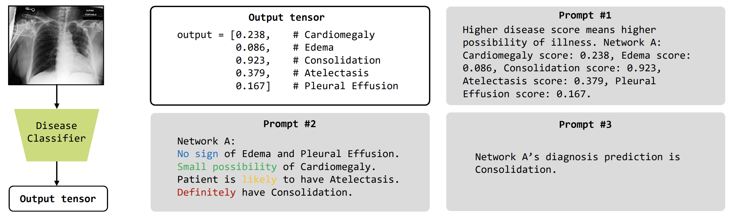
Foundation model for medical AI
Building an Interactive Computer-Aided Diagnosis on Medical Imaging Data using
Large Language Models
Sheng Wang et al. 2023
LLM like ChatGPT has successfully passed part of the US medical licensing exam. However, LLMs currently have difficulty processing images, making it challenging to interpret information from medical images, which are rich in information that supports clinical decisions.
Develop a method for integrating LLMs into medical-image CAD networks. LLM's medical knowledge can be also used to improve the performance of vision-based medical-image CAD models.
Create a more user-friendly and understandable system for patients compared to conventional CAD systems.
22

Slide 35
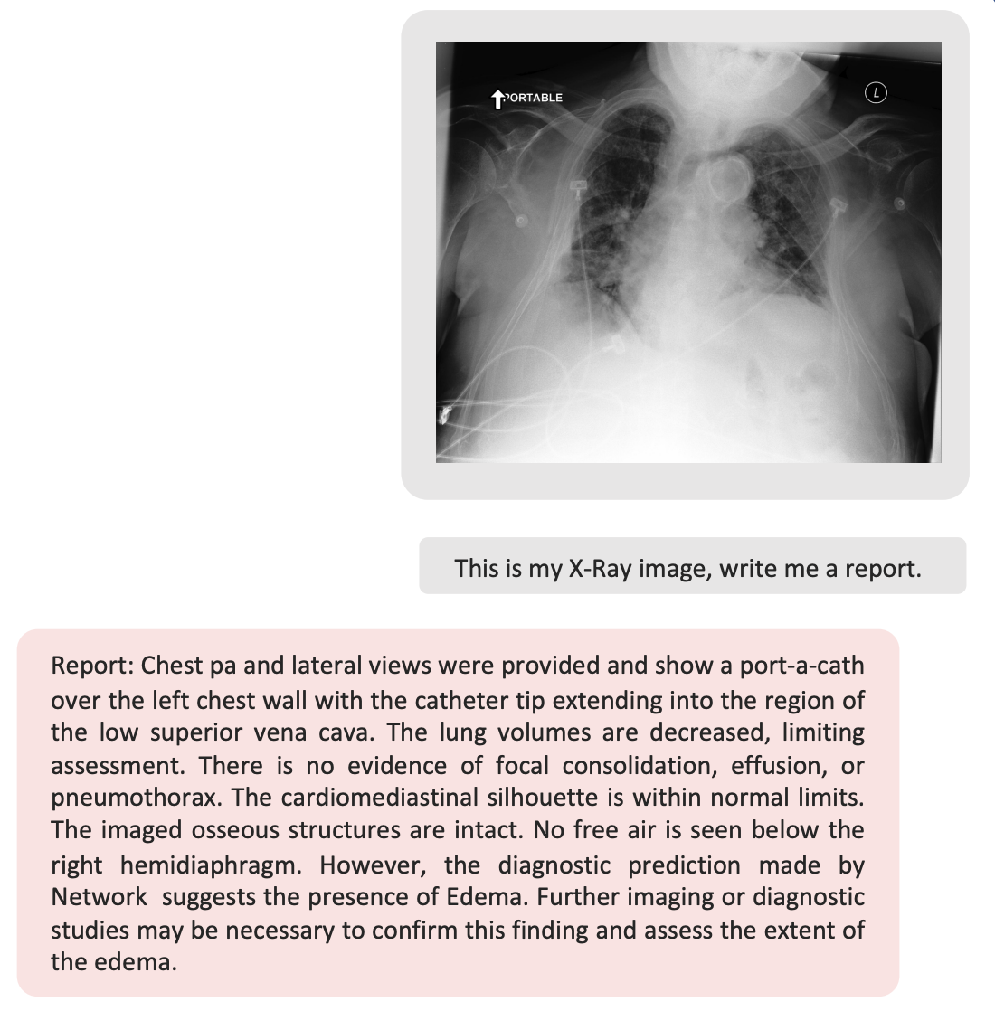
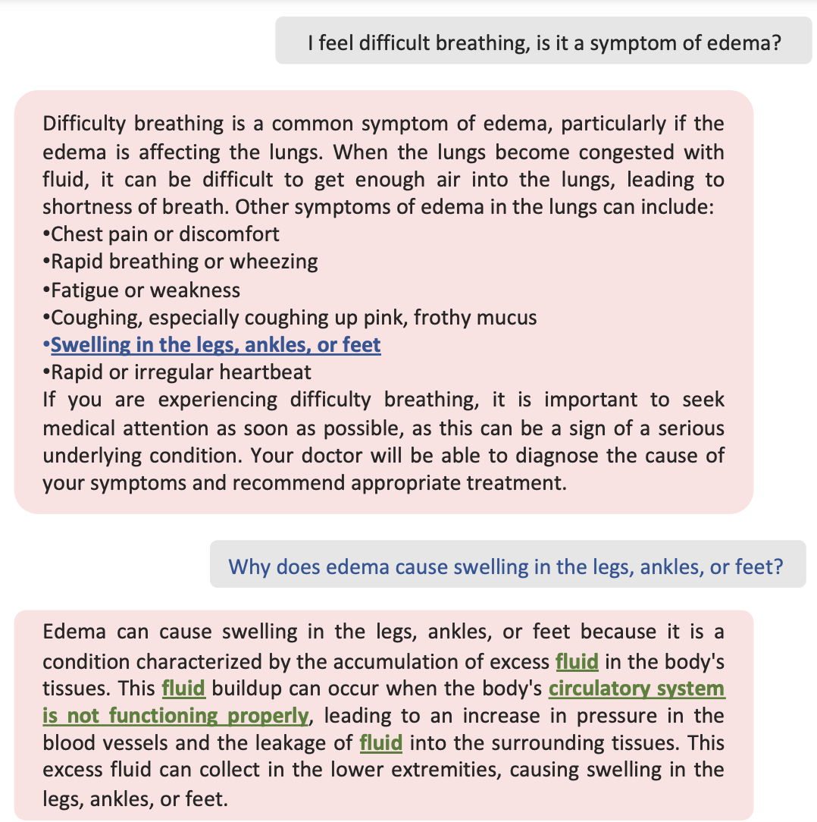
Foundation model for medical AI
Building an Interactive Computer-Aided Diagnosis on Medical Imaging Data using
Large Language Models
Sheng Wang et al. 2023
22

Slide 36
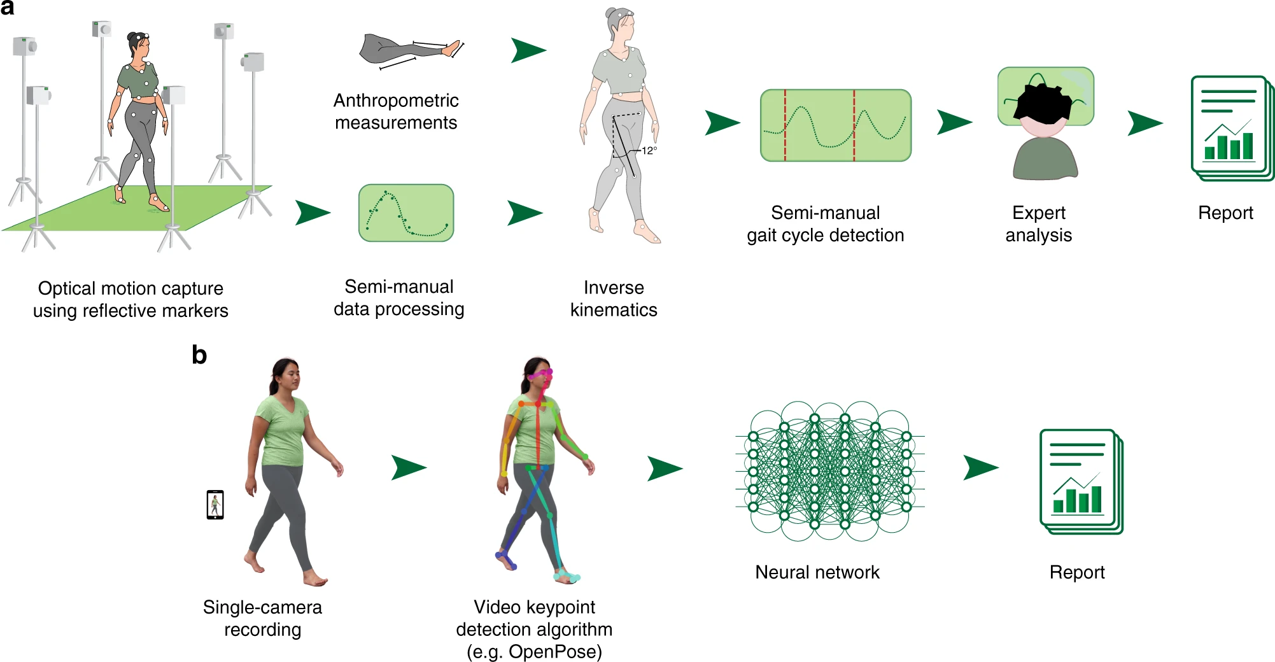
DL-based quantitative movement analysis using single-camera videos
Kidziński, Łukasz, et al. "Deep neural networks enable quantitative movement analysis using single-camera videos." Nature Communications 11.1 (2020): 1-10.
22

Slide 37
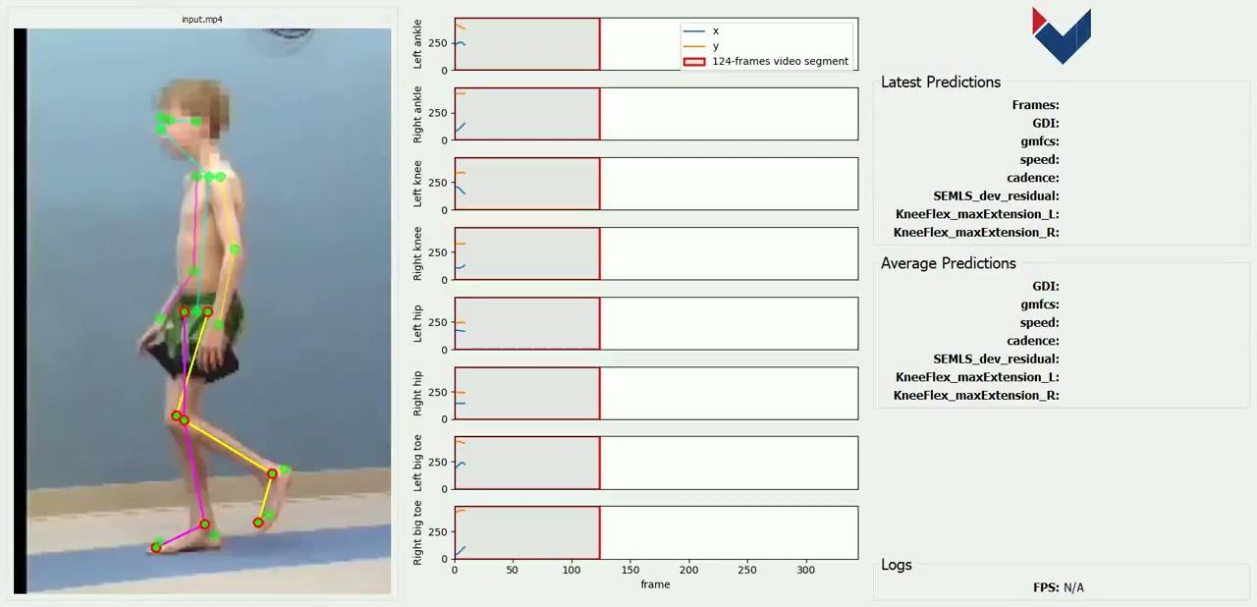
Building large-scale, open and annotated datasets
Quantitative assessment of motion is currently possible only with expensive motion capture systems and highly trained personnel.
Establish a large a dataset of videos of patients diagnosed with cerebral palsy.
Build AI systems to predict clinical gait measures (Gait Deviation Index - GDI and the Gross Motor Function Classification System - GMFCS score)
Kidziński, Łukasz, et al. "Deep neural networks enable quantitative movement analysis using single-camera videos." Nature Communications 11.1 (2020): 1-10.
21

Slide 38
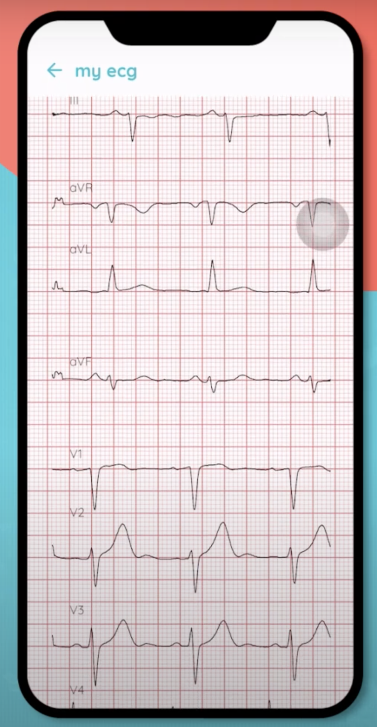
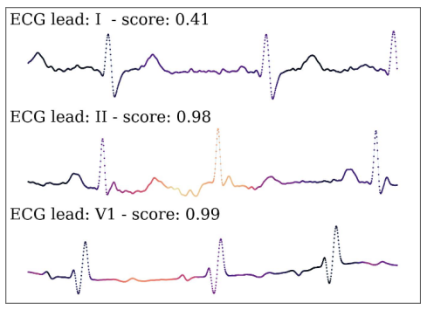
Building large-scale, open and annotated datasets
Collect ECGs data from major hospitals in Vietnam using mobile phones.
Develop a novel deep learning system to accurately identify multiple cardiovascular abnormalities by using only three ECG leads.
Develop explainable AI system to diagnose cardiovascular diseases.
WARNING!
Khiem H. Le, Hieu H. Pham, Thao BT. Nguyen, Tu A. Nguyen, Tien N. Thanh, Cuong D. Do. “LightX3ECG: A Lightweight and eXplainable Deep Learning System for 3-lead Electrocardiogram Classification” https://arxiv.org/abs/2207.12381
23

Slide 39
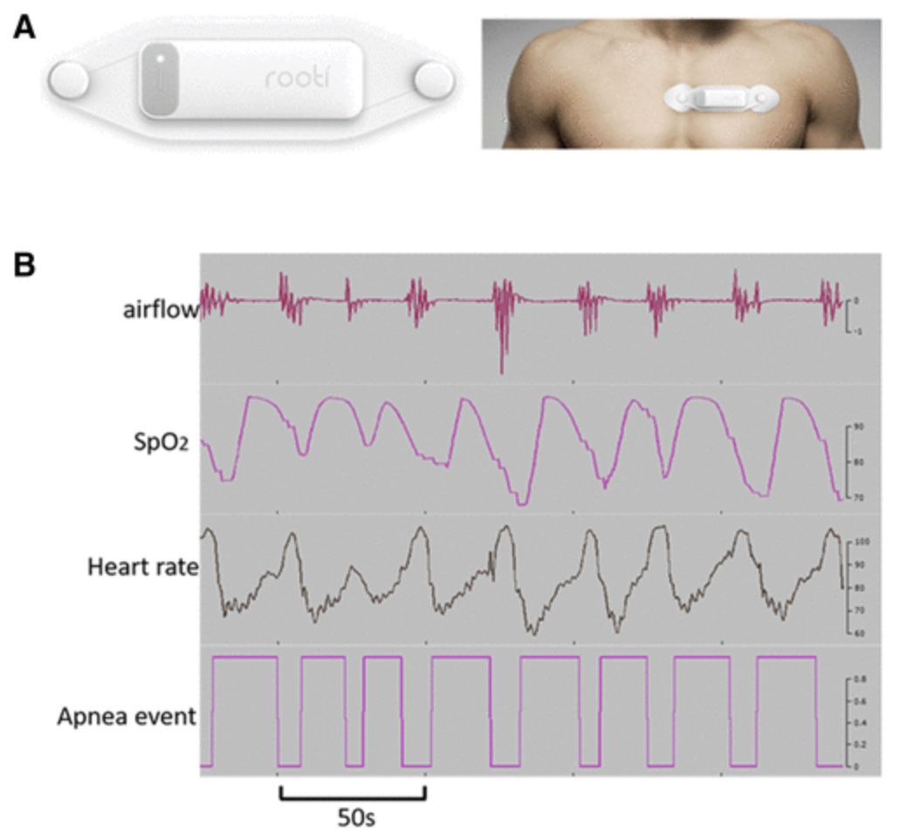
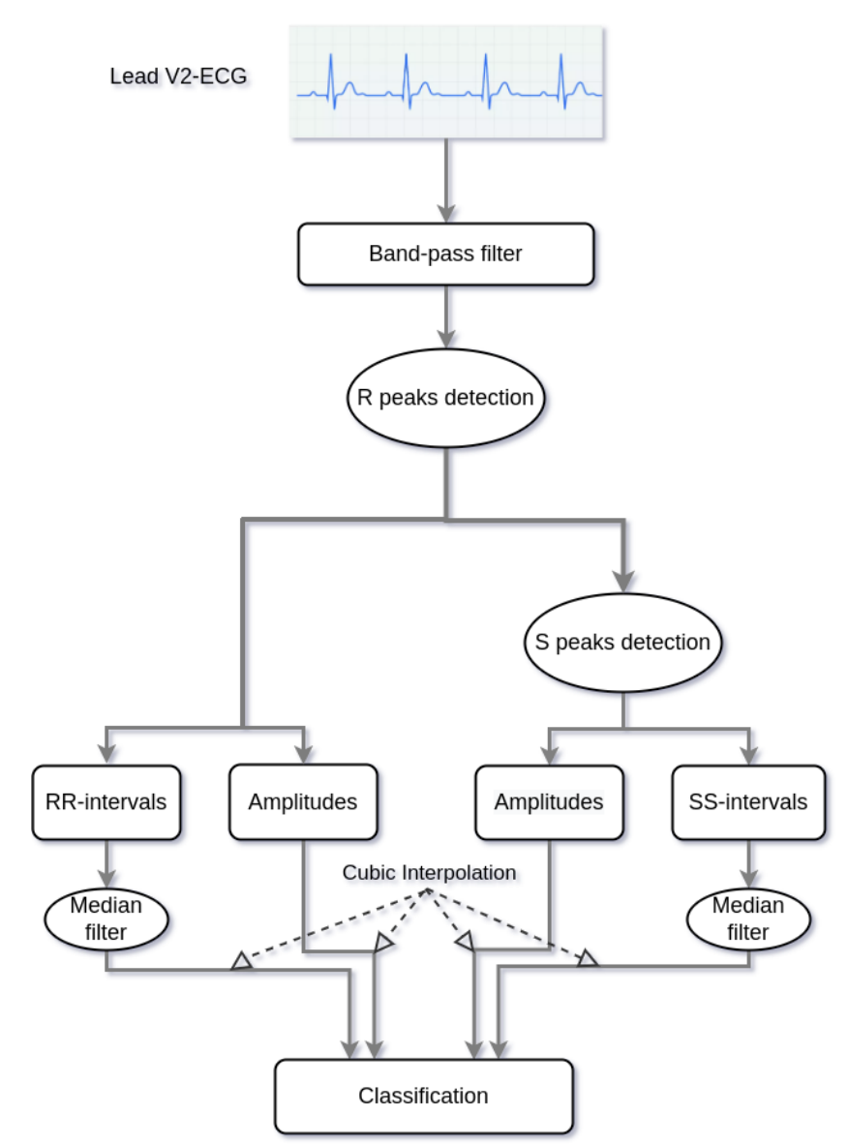
Building large-scale, open and annotated datasets
Collect ECG, EEG and airflow, etc datasets to research sleep apnea diseases.
Develop and evaluate
a novel deep learning-based approach for sleep apnea detection using single-lead ECG signals or multimodal data (EEG+ECG+Airflow+SpO2+Heart rate)
Source
Our works
Khiem H. Le, Hieu H. Pham, Thao BT. Nguyen, Tu A. Nguyen, Tien N. Thanh, Cuong D. Do. “A novel deep learning-based approach for sleep apnea detection using single-lead ECG signals” https://arxiv.org/pdf/2208.03408.pdf
24

Slide 40
THANK YOU!
hieu.ph@vinuni.edu.vn
Learn more about us at https://smarthealth.vinuni.edu.vn/
32

